Slide 1
Data Mining ~ ~ Meet 08 ~ ~ Program Studi Sains Data Universitas Teknologi Yogyakarta
Dr. Donny Avianto, S.T., M.T.

Slide 2
Decision Tree

Slide 3
Apa itu Decision Tree?

Slide 4
Apa itu Decision Tree
Proses pada Decision Tree adalah proses:
mengubah bentuk data (tabel) menjadi bentuk Tree,
Mengubah Tree menjadi Rule,
dan menyederhanakan Rule

Slide 5
Decision Tree
Metode Decision Tree mengubah fakta yang sangat besar menjadi Decision Tree
Decision Tree yang merepresentasikan aturan
Sebuah Decision Tree membagi data yang besar menjadi himpunan-himpunan record yang lebih kecil dengan menerapkan serangkaian aturan keputusan.

Slide 6
Algoritma Decision Tree
Algoritma yang digunakan untuk pembentukan Decision Tree diantaranya: ID3,CART,C4.5
Algoritma C4.5 merupakan pengembangan dari ID3

Slide 7
Contoh kasus
NO | OUTLOOK | TEMPERATUR | HUMIDITY | WINDY | PLAY
1 | Sunny | Hot | High | FALSE | NO
2 | Sunny | Hot | High | TRUE | NO
3 | Cloudy | Hot | High | FALSE | YES
4 | Rainy | Mild | High | FALSE | YES
5 | Rainy | Cool | Normal | FALSE | YES
6 | Rainy | Cool | Normal | TRUE | YES
7 | Cloudy | Cool | Normal | TRUE | YES
8 | Sunny | Mild | High | FALSE | NO
9 | Sunny | Cool | Normal | FALSE | YES
10 | Rainy | Mild | Normal | FALSE | YES
11 | Sunny | Mild | Normal | TRUE | YES
12 | Cloudy | Mild | High | TRUE | YES
13 | Cloudy | Hot | Normal | FALSE | YES
14 | Rainy | Mild | High | TRUE | NO

Slide 8
Algoritma C4.5
Hitung entropy untuk semua kasus yang ada
Hitung entropy untuk semua fitur / pemisah / splitter yang ada
Hitung nilai gain untuk masing-masing fitur / pemisah / splitter yang ada
Pilih atribut sebagai akar
Buat cabang untuk tiap-tiap nilai
Bagi kasus dalam cabang
Ulangi proses untuk setiap cabang sampai semua kasus pada cabang memiliki kelas yang sama

Slide 9

Entropy
$$Entropy\left(S\right)=\sum_{i=1}^{n}{{−p}_{i}} ×\log_{2}{p_{i}}$$
S = himpunan kasus
N = jml partisi S
$p_{i}$ = proporsi Si terhadap S

Slide 10
Entropy
Fungsi utama dari menghitung entropy adalah untuk mengukur ketidakteraturan atau ketidakpastian dalam data
Semakin tinggi nilai entropy, semakin besar tingkat ketidakpastian dalam dataset
nilai entropy tinggi, ini menunjukkan bahwa data tidak memiliki pola atau informasi yang jelas

Slide 11
Entropy
Tujuan utama pembuatan decision tree, adalah untuk mengurangi entropy
dengan cara memilih fitur/atribut yang membagi data ke dalam subset yang lebih homogen berdasarkan kelas target,
sehingga mengurangi ketidakpastian atau ketidakteraturan dalam setiap cabang pohon keputusan

Slide 12
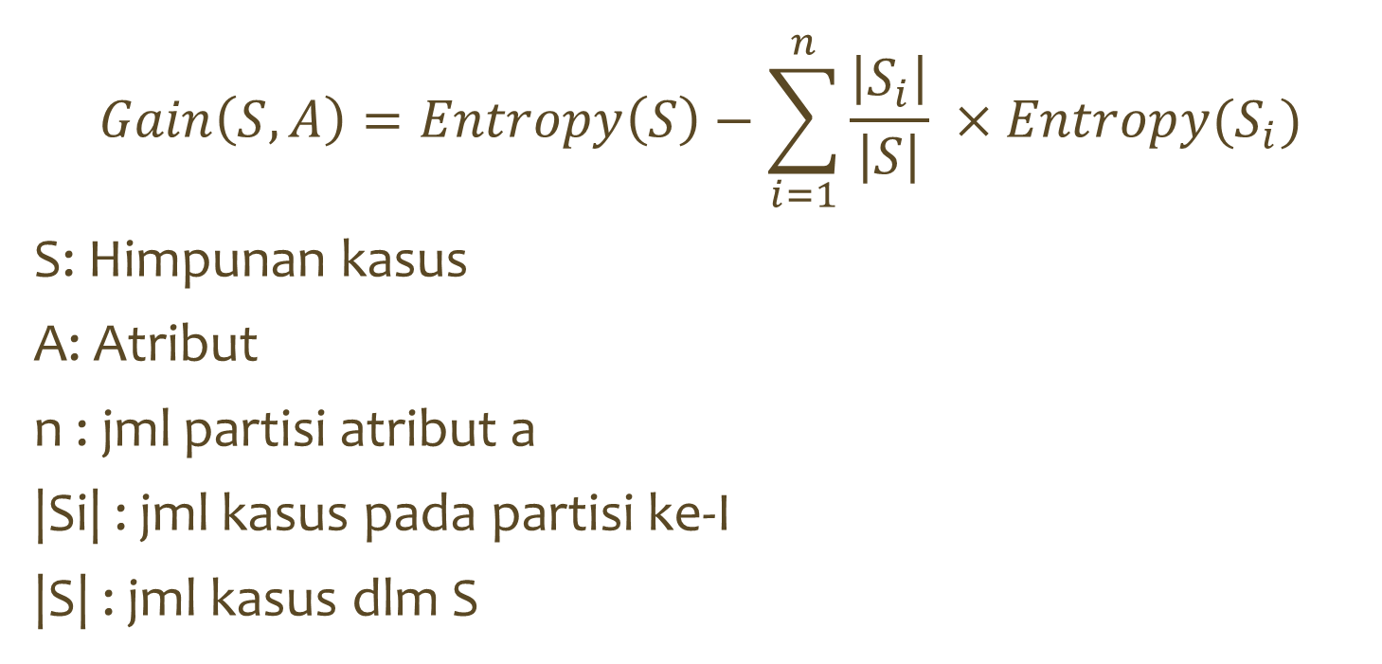
Gain
$$Gain\left(S,A\right)=Entropy\left(S\right)−\sum_{i=1}^{n}{\frac{\left|S_{i}\right|}{\left|S\right|}} ×Entropy(S_{i})$$
S: Himpunan kasus
A: Atribut
n : jml partisi atribut a
|Si| : jml kasus pada partisi ke-I
|S| : jml kasus dlm S

Slide 13
Gain / Information Gain
Fungsi utama dari menghitung gain adalah untuk menentukan atribut mana yang paling baik untuk digunakan sebagai pemisah (splitter) pada setiap langkah dalam pembentukan pohon keputusan
Gain informasi dihitung sebagai perbedaan antara entropy sebelum dan setelah pemisahan data berdasarkan atribut tertentu

Slide 14
Meringkas JML Kasus
NO | OUTLOOK | TEMPERATUR | HUMIDITY | WINDY | PLAY
1 | Sunny | Hot | High | FALSE | NO
2 | Sunny | Hot | High | TRUE | NO
3 | Cloudy | Hot | High | FALSE | YES
4 | Rainy | Mild | High | FALSE | YES
5 | Rainy | Cool | Normal | FALSE | YES
6 | Rainy | Cool | Normal | TRUE | YES
7 | Cloudy | Cool | Normal | TRUE | YES
8 | Sunny | Mild | High | FALSE | NO
9 | Sunny | Cool | Normal | FALSE | YES
10 | Rainy | Mild | Normal | FALSE | YES
11 | Sunny | Mild | Normal | TRUE | YES
12 | Cloudy | Mild | High | TRUE | YES
13 | Cloudy | Hot | Normal | FALSE | YES
14 | Rainy | Mild | High | TRUE | NO
 |  |  | JML Kasus | NO | YES
 | TOTAL
 | OUTLOOK
 |  | Cloudy
 |  | Rainy
 |  | Sunny
 | TEMPERATUR
 |  | Cool
 |  | Hot
 |  | Mild
 | HUMIDITY
 |  | High
 |  | Normal
 | WINDY
 |  | FALSE
 |  | TRUE

Slide 15
Meringkas JML Kasus
NO | OUTLOOK | TEMPERATUR | HUMIDITY | WINDY | PLAY
1 | Sunny | Hot | High | FALSE | NO
2 | Sunny | Hot | High | TRUE | NO
3 | Cloudy | Hot | High | FALSE | YES
4 | Rainy | Mild | High | FALSE | YES
5 | Rainy | Cool | Normal | FALSE | YES
6 | Rainy | Cool | Normal | TRUE | YES
7 | Cloudy | Cool | Normal | TRUE | YES
8 | Sunny | Mild | High | FALSE | NO
9 | Sunny | Cool | Normal | FALSE | YES
10 | Rainy | Mild | Normal | FALSE | YES
11 | Sunny | Mild | Normal | TRUE | YES
12 | Cloudy | Mild | High | TRUE | YES
13 | Cloudy | Hot | Normal | FALSE | YES
14 | Rainy | Mild | High | TRUE | NO
 |  |  | JML Kasus | NO | YES
 | TOTAL |  | 14 | 4 | 10
 | OUTLOOK
 |  | Cloudy | 4 | 0 | 4
 |  | Rainy
 |  | Sunny
 | TEMPERATUR
 |  | Cool
 |  | Hot
 |  | Mild
 | HUMIDITY
 |  | High
 |  | Normal
 | WINDY
 |  | FALSE
 |  | TRUE

Slide 16
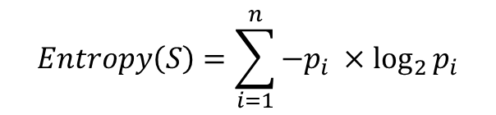
Menghitung Entropy Total
Node1
Node |  |  | JML Kasus | NO | YES | Entropy | Gain
1 | TOTAL |  | 14 | 4 | 10
 | OUTLOOK
 |  | Cloudy | 4 | 0 | 4
 |  | Rainy | 5 | 1 | 4
 |  | Sunny | 5 | 3 | 2
 | TEMPERATUR
 |  | Cool | 4 | 0 | 4
 |  | Hot | 4 | 2 | 2
 |  | Mild | 6 | 2 | 4
 | HUMIDITY
 |  | High | 7 | 4 | 3
 |  | Normal | 7 | 0 | 7
 | WINDY
 |  | FALSE | 8 | 2 | 6
 |  | TRUE | 6 | 2 | 4
$$Entropy\left(S\right)=\sum_{i=1}^{n}{{−p}_{i}} ×\log_{2}{p_{i}}$$
Entropy(Total)=(-4/14*log2(4/14))+
(-10/14 * log2(10/14))
Entropy(Total)=0.863121

Slide 17
Menghitung Entropy Total
Node1
Node |  |  | JML Kasus | NO | YES | Entropy | Gain
1 | TOTAL |  | 14 | 4 | 10 | 0.863121
 | OUTLOOK
 |  | Cloudy | 4 | 0 | 4
 |  | Rainy | 5 | 1 | 4
 |  | Sunny | 5 | 3 | 2
 | TEMPERATUR
 |  | Cool | 4 | 0 | 4
 |  | Hot | 4 | 2 | 2
 |  | Mild | 6 | 2 | 4
 | HUMIDITY
 |  | High | 7 | 4 | 3
 |  | Normal | 7 | 0 | 7
 | WINDY
 |  | FALSE | 8 | 2 | 6
 |  | TRUE | 6 | 2 | 4
$$Entropy\left(S\right)=\sum_{i=1}^{n}{{−p}_{i}} ×\log_{2}{p_{i}}$$
Entropy(Total)=(-4/14*log2(4/14))+
(-10/14 * log2(10/14))
Entropy(Total)=0.863121

Slide 18
Menghitung Entropy Total
Node1
Node |  |  | JML Kasus | NO | YES | Entropy | Gain
1 | TOTAL |  | 14 | 4 | 10 | 0.863121
 | OUTLOOK
 |  | Cloudy | 4 | 0 | 4 | 0
 |  | Rainy | 5 | 1 | 4 | 0.7219281
 |  | Sunny | 5 | 3 | 2 | 0.9709506
 | TEMPERATUR
 |  | Cool | 4 | 0 | 4 | 0
 |  | Hot | 4 | 2 | 2 | 1
 |  | Mild | 6 | 2 | 4 | 0.9182958
 | HUMIDITY
 |  | High | 7 | 4 | 3 | 0.9852281
 |  | Normal | 7 | 0 | 7 | 0
 | WINDY
 |  | FALSE | 8 | 2 | 6 | 0.8112781
 |  | TRUE | 6 | 2 | 4 | 0.9182958

Slide 19
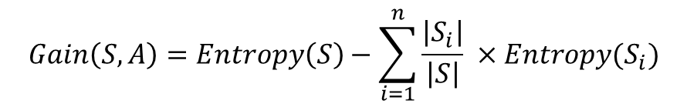
Menghitung Gain
Node1
Node |  |  | JML Kasus | NO | YES | Entropy | Gain
1 | TOTAL |  | 14 | 4 | 10 | 0.863121
 | OUTLOOK
 |  | Cloudy | 4 | 0 | 4 | 0
 |  | Rainy | 5 | 1 | 4 | 0.7219281
 |  | Sunny | 5 | 3 | 2 | 0.9709506
 | TEMPERATUR
 |  | Cool | 4 | 0 | 4 | 0
 |  | Hot | 4 | 2 | 2 | 1
 |  | Mild | 6 | 2 | 4 | 0.9182958
 | HUMIDITY
 |  | High | 7 | 4 | 3 | 0.9852281
 |  | Normal | 7 | 0 | 7 | 0
 | WINDY
 |  | FALSE | 8 | 2 | 6 | 0.8112781
 |  | TRUE | 6 | 2 | 4 | 0.9182958
$$Gain\left(S,A\right)=Entropy\left(S\right)−\sum_{i=1}^{n}{\frac{\left|S_{i}\right|}{\left|S\right|}} ×Entropy(S_{i})$$
Gain(Total,OutLook)= Entropy(Total) –
n
∑ |OutLook| * Entropy(OutLook)
i=1 |Total|
Gain(Total,OutLook)= 0.8631206 –
((4/14*0)+(5/14*0.722)+(5/14*0.97))
Gain(Total,OutLook)=0,258521

Slide 20
Menghitung Gain
Node1
Node |  |  | JML Kasus | NO | YES | Entropy | Gain
1 | TOTAL |  | 14 | 4 | 10 | 0.863121
 | OUTLOOK |  |  |  |  |  | 0.258521
 |  | Cloudy | 4 | 0 | 4 | 0
 |  | Rainy | 5 | 1 | 4 | 0.7219281
 |  | Sunny | 5 | 3 | 2 | 0.9709506
 | TEMPERATUR
 |  | Cool | 4 | 0 | 4 | 0
 |  | Hot | 4 | 2 | 2 | 1
 |  | Mild | 6 | 2 | 4 | 0.9182958
 | HUMIDITY
 |  | High | 7 | 4 | 3 | 0.9852281
 |  | Normal | 7 | 0 | 7 | 0
 | WINDY
 |  | FALSE | 8 | 2 | 6 | 0.8112781
 |  | TRUE | 6 | 2 | 4 | 0.9182958
$$Gain\left(S,A\right)=Entropy\left(S\right)−\sum_{i=1}^{n}{\frac{\left|S_{i}\right|}{\left|S\right|}} ×Entropy(S_{i})$$
Gain(Total,OutLook)= Entropy(Total) –
n
∑ |OutLook| * Entropy(OutLook)
i=1 |Total|
Gain(Total,OutLook)= 0.8631206 –
((4/14*0)+(5/14*0.722)+(5/14*0.97))
Gain(Total,OutLook)=0,258521

Slide 21
Menghitung Gain
Node1
Node |  |  | JML Kasus | NO | YES | Entropy | Gain
1 | TOTAL |  | 14 | 4 | 10 | 0.863121
 | OUTLOOK |  |  |  |  |  | 0.258521
 |  | Cloudy | 4 | 0 | 4 | 0
 |  | Rainy | 5 | 1 | 4 | 0.7219281
 |  | Sunny | 5 | 3 | 2 | 0.9709506
 | TEMPERATUR |  |  |  |  |  | 0.183851
 |  | Cool | 4 | 0 | 4 | 0
 |  | Hot | 4 | 2 | 2 | 1
 |  | Mild | 6 | 2 | 4 | 0.9182958
 | HUMIDITY |  |  |  |  |  | 0.370507
 |  | High | 7 | 4 | 3 | 0.9852281
 |  | Normal | 7 | 0 | 7 | 0
 | WINDY |  |  |  |  |  | 0.005978
 |  | FALSE | 8 | 2 | 6 | 0.8112781
 |  | TRUE | 6 | 4 | 2 | 0.9182958

Slide 22
Menghitung Gain
1
HUMIDITY
Node1
Node |  |  | JML Kasus | NO | YES | Entropy | Gain
1 | TOTAL |  | 14 | 4 | 10 | 0.863121
 | OUTLOOK |  |  |  |  |  | 0.258521
 |  | Cloudy | 4 | 0 | 4 | 0
 |  | Rainy | 5 | 1 | 4 | 0.7219281
 |  | Sunny | 5 | 3 | 2 | 0.9709506
 | TEMPERATUR |  |  |  |  |  | 0.183851
 |  | Cool | 4 | 0 | 4 | 0
 |  | Hot | 4 | 2 | 2 | 1
 |  | Mild | 6 | 2 | 4 | 0.9182958
 | HUMIDITY |  |  |  |  |  | 0.370507
 |  | High | 7 | 4 | 3 | 0.9852281
 |  | Normal | 7 | 0 | 7 | 0
 | WINDY |  |  |  |  |  | 0.005978
 |  | FALSE | 8 | 2 | 6 | 0.8112781
 |  | TRUE | 6 | 4 | 2 | 0.9182958
Normal
High
1.1
YES

Slide 23
1
HUMIDITY
NO | OUTLOOK | TEMPERATUR | HUMIDITY | WINDY | PLAY
1 | Sunny | Hot | High | FALSE | NO
2 | Sunny | Hot | High | TRUE | NO
3 | Cloudy | Hot | High | FALSE | YES
4 | Rainy | Mild | High | FALSE | YES
8 | Sunny | Mild | High | FALSE | NO
12 | Cloudy | Mild | High | TRUE | YES
14 | Rainy | Mild | High | TRUE | NO
5 | Rainy | Cool | Normal | FALSE | YES
6 | Rainy | Cool | Normal | TRUE | YES
7 | Cloudy | Cool | Normal | TRUE | YES
9 | Sunny | Cool | Normal | FALSE | YES
10 | Rainy | Mild | Normal | FALSE | YES
11 | Sunny | Mild | Normal | TRUE | YES
13 | Cloudy | Hot | Normal | FALSE | YES
Normal
High
1.1
YES

Slide 24
1
HUMIDITY
NO | OUTLOOK | TEMPERATUR | HUMIDITY | WINDY | PLAY
1 | Sunny | Hot | High | FALSE | NO
2 | Sunny | Hot | High | TRUE | NO
3 | Cloudy | Hot | High | FALSE | YES
4 | Rainy | Mild | High | FALSE | YES
8 | Sunny | Mild | High | FALSE | NO
12 | Cloudy | Mild | High | TRUE | YES
14 | Rainy | Mild | High | TRUE | NO
5 | Rainy | Cool | Normal | FALSE | YES
6 | Rainy | Cool | Normal | TRUE | YES
7 | Cloudy | Cool | Normal | TRUE | YES
9 | Sunny | Cool | Normal | FALSE | YES
10 | Rainy | Mild | Normal | FALSE | YES
11 | Sunny | Mild | Normal | TRUE | YES
13 | Cloudy | Hot | Normal | FALSE | YES
Normal
High
1.1
YES

Slide 25
NO | OUTLOOK | TEMPERATUR | HUMIDITY | WINDY | PLAY
1 | Sunny | Hot | High | FALSE | NO
2 | Sunny | Hot | High | TRUE | NO
3 | Cloudy | Hot | High | FALSE | YES
4 | Rainy | Mild | High | FALSE | YES
8 | Sunny | Mild | High | FALSE | NO
12 | Cloudy | Mild | High | TRUE | YES
14 | Rainy | Mild | High | TRUE | NO
5 | Rainy | Cool | Normal | FALSE | YES
6 | Rainy | Cool | Normal | TRUE | YES
7 | Cloudy | Cool | Normal | TRUE | YES
9 | Sunny | Cool | Normal | FALSE | YES
10 | Rainy | Mild | Normal | FALSE | YES
11 | Sunny | Mild | Normal | TRUE | YES
13 | Cloudy | Hot | Normal | FALSE | YES
Node1.1
Node |  |  | JML Kasus | NO | YES | Entropy | Gain
1.1 | HUMIDITY-HIGH |  | 7 | 4 | 3
 | OUTLOOK
 |  | Cloudy
 |  | Rainy
 |  | Sunny
 | TEMPERATUR
 |  | Cool
 |  | Hot
 |  | Mild
 | WINDY
 |  | FALSE
 |  | TRUE

Slide 26
NO | OUTLOOK | TEMPERATUR | HUMIDITY | WINDY | PLAY
1 | Sunny | Hot | High | FALSE | NO
2 | Sunny | Hot | High | TRUE | NO
3 | Cloudy | Hot | High | FALSE | YES
4 | Rainy | Mild | High | FALSE | YES
8 | Sunny | Mild | High | FALSE | NO
12 | Cloudy | Mild | High | TRUE | YES
14 | Rainy | Mild | High | TRUE | NO
5 | Rainy | Cool | Normal | FALSE | YES
6 | Rainy | Cool | Normal | TRUE | YES
7 | Cloudy | Cool | Normal | TRUE | YES
9 | Sunny | Cool | Normal | FALSE | YES
10 | Rainy | Mild | Normal | FALSE | YES
11 | Sunny | Mild | Normal | TRUE | YES
13 | Cloudy | Hot | Normal | FALSE | YES
Node1.1
Node |  |  | JML Kasus | NO | YES | Entropy | Gain
1.1 | HUMIDITY-HIGH |  | 7 | 4 | 3
 | OUTLOOK
 |  | Cloudy | 2 | 0 | 2
 |  | Rainy | 2 | 1 | 1
 |  | Sunny | 3 | 3 | 0
 | TEMPERATUR
 |  | Cool | 0 | 0 | 0
 |  | Hot | 3 | 2 | 1
 |  | Mild | 4 | 2 | 2
 | WINDY
 |  | FALSE | 4 | 2 | 2
 |  | TRUE | 3 | 2 | 1
dst…

Slide 27
Terima Kasih
Ada Pertanyaan…???

